Slide 1
Fiber Optic Communication
Sujan Chandra Roy
Lecturer
Department of CSE, REC

Slide 2
Definition
Fiber-optic communication is a method of transmitting information from one place to another by sending pulses of light through an optical fiber.
The light forms an electromagnetic carrier wave that is modulated to carry information.
Optical fiber is used by many telecommunications companies to transmit telephone signals, Internet communication, and cable television signals.

Slide 3
Why optical fiber?
Because of rapidly increasing demands for telephone communications throughout the world, multi conductor copper cables have become not only very expensive but also an inefficient way to meet these information requirements. The following examples illustrate and emphasize the reasons for using optical fibers:
The lightweight and non-corrosiveness of the fiber make it very practical for aircraft an automotive application.
A simple fiber can handle as many voice channels as a 1500-pair cable can.
The spacing of repeaters from 35 to 80 Km for fibers, as opposed to form 1 to 1.5 Km for wire, is a great advantage.
Fiber is immune to interference from lightning, cross talk and electromagnetic radiation.

Slide 4
Need of fiber optic communication
Fiber optic communication system has emerged as most important communication system. Compared to traditional system because of following requirements :
In long haul transmission system there is need of low loss transmission medium. ( almost 0.25 dB @1550 nm)
There is need of compact and least weight transmitters and receivers
There is need of increased span of transmission
There is need of increased bit rate-distance product.
It has very high bandwidth ( 30 THz )
A fiber optic communication system fulfills these requirements, hence most
widely acceptation.

Slide 5
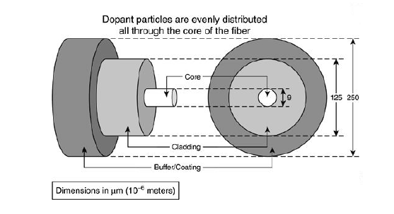
Construction/ Different parts:

Slide 6
Construction/ Different parts:
The fiber consists of the following:
Core (n1 ): Core is the highly refractive central region of an optical fiber through which light is transmitted. Diameter of core in use with single mode fiber is 8 to10 μm and with multimode fiber is between 50 to 62.5 μm. The core is made of silica glass or plastic.
Cladding (n2): Outer optical material surrounding the core that reflects the light back into the core. Its index of refractive is lower than the core. The diameter of the cladding surrounding core is 125 μm.
Coating or Buffer coating or jacket (applied by the fiber manufactured to protect the core and cladding): Plastic coating that protects the fiber from damage and moisture. Standard size is 250μm-900μm.

Slide 7
Comparison with electrical transmission
Depend on applications.
Optical fiber is generally chosen for systems requiring higher bandwidth or spanning longer distances than electrical cabling can accommodate.
The main benefits of fiber are its exceptionally low loss.
Its inherently high data-carrying capacity.
Thousands of electrical links would be required to replace a single high bandwidth fiber cable.
Fiber cables experience effectively no crosstalk, in contrast to some types of electrical transmission lines.
Fiber can be installed in areas with high electromagnetic interference (EMI), such as alongside utility lines, power lines, and railroad tracks.

Slide 8
Total Internal Reflection
When a ray of light travels from a denser to a rarer medium such that the angle of incidence is greater than the critical angle, the ray reflects back into the same medium this phenomena is called total internal reflection.
In the optical fiber the rays undergo repeated total number of reflections until it emerges out of the other end of the fiber, even if the fiber is bent.

Slide 9
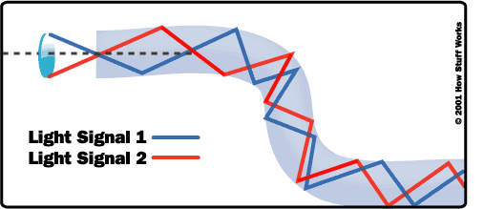
Total internal reflection in optical fiber

Slide 10
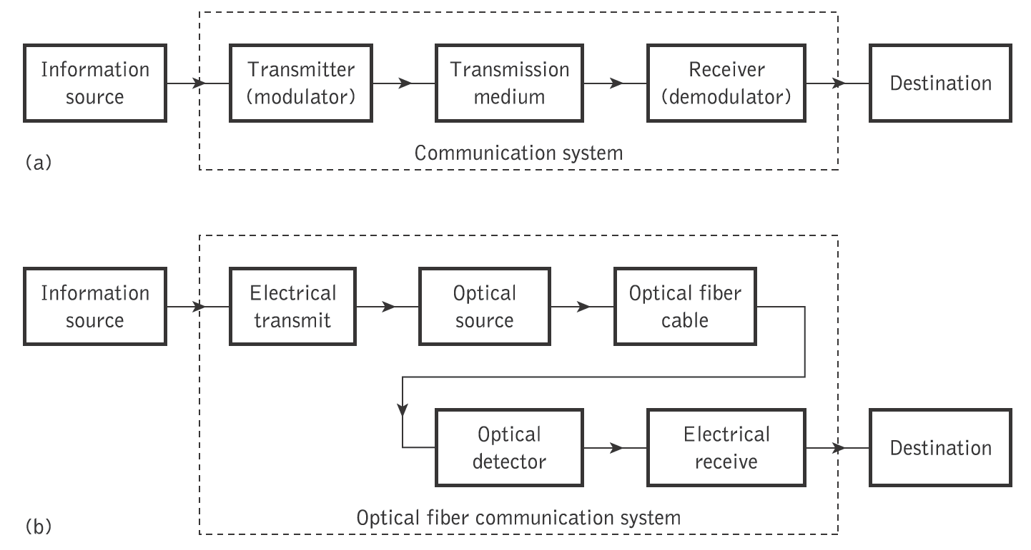
The general system
An optical fiber communication system is similar in basic concept to any type of communication system.
A block schematic of a general communication system is shown in Figure 1.2(a),

Slide 11
Information source- it provides an electrical signal to a transmitter comprising an electrical stage.
Electrical transmitter- It drives an optical source to give an modulation of the light wave carrier.
Optical source- It provides the electrical-optical conversion .It may be a semiconductor laser or an LED.

Slide 12
Optical cable: It serves as transmission medium.
Optical detector: It is responsible for optical to electrical conversion of data and hence responsible for demodulation of the optical carrier. It may be a photodiodes, phototransistor, and photoconductors.
Electrical receiver: It is used for electrical interfacing at the receiver end of the optical link and to perform the signal processing electrically.
Destination: It is the final point at which we receive the information in the form of electrical signal.

Slide 13
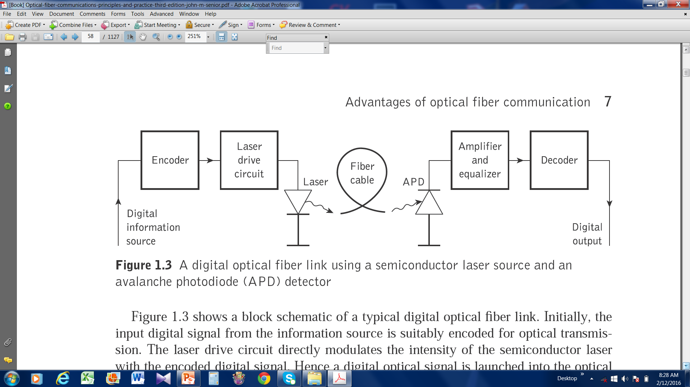

Slide 14
How a Fiber Optic Communication Works?
Unlike copper wire based transmission where the transmission entirely depends on electrical signals passing through the cable, the fiber optics transmission involves transmission of signals in the form of light from one point to the other. Furthermore, a fiber optic communication network consists of transmitting and receiving circuitry, a light source and detector devices like the ones shown in the figure.
When the input data, in the form of electrical signals, is given to the transmitter circuitry, it converts them into light signal with the help of a light source. This source is of LED whose amplitude, frequency and phases must remain stable and free from fluctuation in order to have efficient transmission. The light beam from the source is carried by a fiber optic cable to the destination circuitry wherein the information is transmitted back to the electrical signal by a receiver circuit.

Slide 15
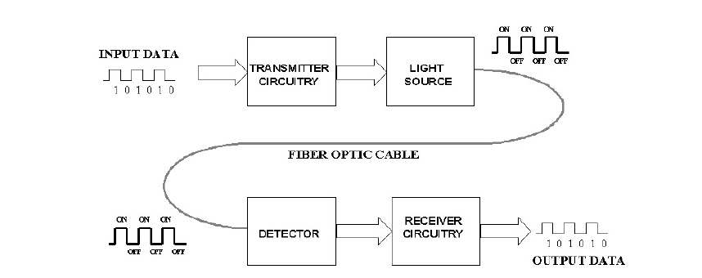
The Receiver circuit consists of a photo detector along with an appropriate electronic circuit, which is capable of measuring magnitude, frequency and phase of the optic field. This type of communication uses the wave lengths near to the infrared band that are just above the visible range. Both LED and Laser can be used as light sources based on the application.

Slide 16
Glass and Plastic fibers
Based on materials in which the fibers are made it is classified into two types as follows:
Glass fibers : If the fibers are made up of mixture of metal oxides and silica glasses are called glass fibers.
Examples:- (i) Core: SiO2 ; cladding: P2O3 – SiO2
(ii) Core: GeO2 – SiO2 ; cladding: SiO2
ii. Plastic fibers: If the fibers are made up plastics which can be handled without any care due to its toughness and durability it is called plastic fiber.
Examples:- The plastic fibers are made by any one of the following combinations of core and cladding.
(i) Core: Polymethylmethacrylate; cladding: co-polymer.
(ii) Core: Polystyrene; cladding: Methyl methacrylate.

Slide 17
Differentiate between glass and plastic fiber cables.
Fiber optic cables are made from glass and fiber. Glass has the lowest loss but it is brittle. Plastic is cheaper and more flexible but has high attenuation.

Slide 18
Advantages of optical fiber communication
(a) Enormous potential bandwidth: The optical carrier frequency in the range 10¹³ to 10¹⁶ Hz yields; >> metallic cable systems or even millimeter wave radio systems.
(b) Small size and weight: small diameters < diameter of a human hair.
Therefore it is useful for such as aircraft, satellites and even ships.

Slide 19
(c) Electrical isolation: electrical insulators and therefore, do not exhibit interface problems.
Transmission ideally suited for communication in electrically hazardous environments.
(d) Immunity to interference and crosstalk: Optical fibers form a dielectric waveguide and are therefore free from electromagnetic interference (EMI), radio-frequency interference (RFI).
Hence the system is unaffected by transmission through an electrically noisy environment and the fiber cable requires no shielding from EMI.
Moreover, there is no optical interference between fibers and hence, crosstalk is negligible.

Slide 20
(e) Signal security: The light from optical fibers does not radiate significantly and therefore they provide a high degree of signal security.
(f) Low transmission loss: It exhibits very low attenuation or transmission loss in comparison with the best copper conductors.
Fibers have been fabricated with losses as low as 0.15 dB km⁻¹ and this feature has become a major advantage of optical fiber communications.
(g) Ruggedness and flexibility: The fibers may be bent to quite small radii or twisted without damage.

Slide 21
(h) System reliability and ease of maintenance: the low-loss property of optical fiber cables reduces the requirement for intermediate repeaters or line amplifiers to boost the transmitted signal strength.
(i) Potential low cost: made from sand, potential for low-cost line communication.
Bulk purchase has become competitive with copper wires.

Slide 22
Disadvantage
Highly skilled staff would be required for maintenance
Only point to point working is possible on optical fiber
Precise and costly instruments would be required
Costly if under utilized.
Accept unipolar codes only.
Jointing of fiber and splicing is also time consuming.

Slide 23
Applications
Optical fiber have wider range of application in almost all field, some are been specified below
In telecommunication field
In space applications
Broadband applications
Computer applications industrial applications
Mining applications
In medical applications
In military applications etc.

Slide 24
This is the mechanism of propagating light via an optical fiber with low loss.
Figure 2.3 illustrates the transmission of a light ray in an optical fiber via a series of total internal reflections
The ray has an angle of incidence φ at the interface which is greater than the critical angle and is reflected at the same angle to the normal.

Slide 25
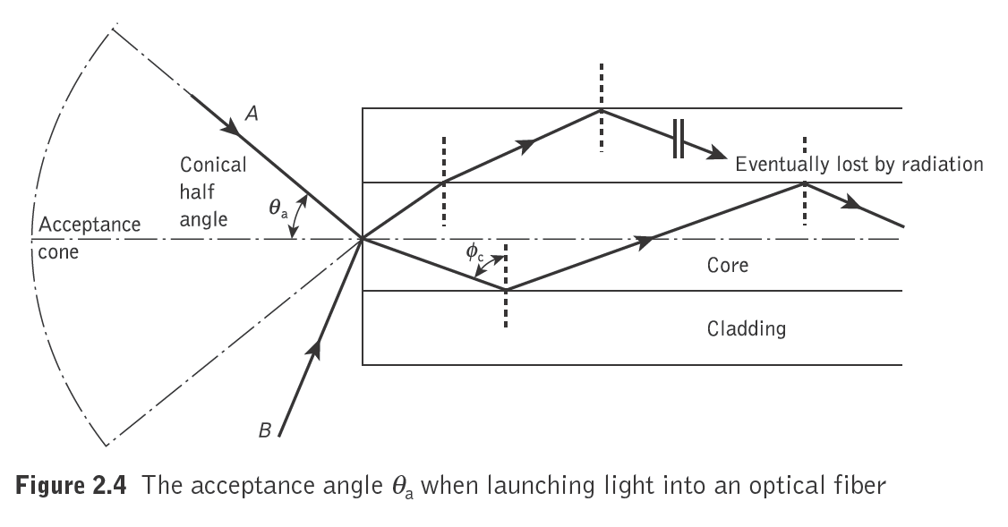
Acceptance angle
For transition of light by total internal reflection within the fiber core, light must be incident on the fiber core within an acceptance cone defined by the conical half angle θ_{a}.
Hence θ_{a} is the maximum angle to the axis at which light may enter the fiber in order to be propagated, and is often referred to as the acceptance angle for the fiber.

Slide 26
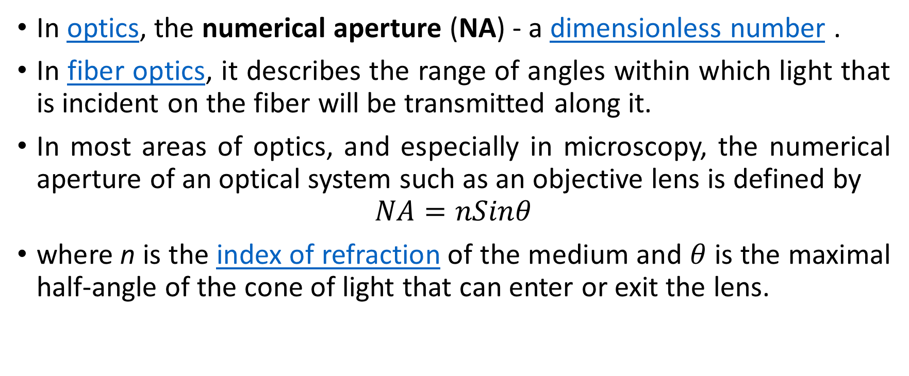
Numerical Aperture
In optics, the numerical aperture (NA) - a dimensionless number .
In fiber optics, it describes the range of angles within which light that is incident on the fiber will be transmitted along it.
In most areas of optics, and especially in microscopy, the numerical aperture of an optical system such as an objective lens is defined by
$$NA=nSinθ$$
where n is the index of refraction of the medium and $θ$ is the maximal half-angle of the cone of light that can enter or exit the lens.
https://en.wikipedia.org/wiki/Numerical_aperture

Slide 27
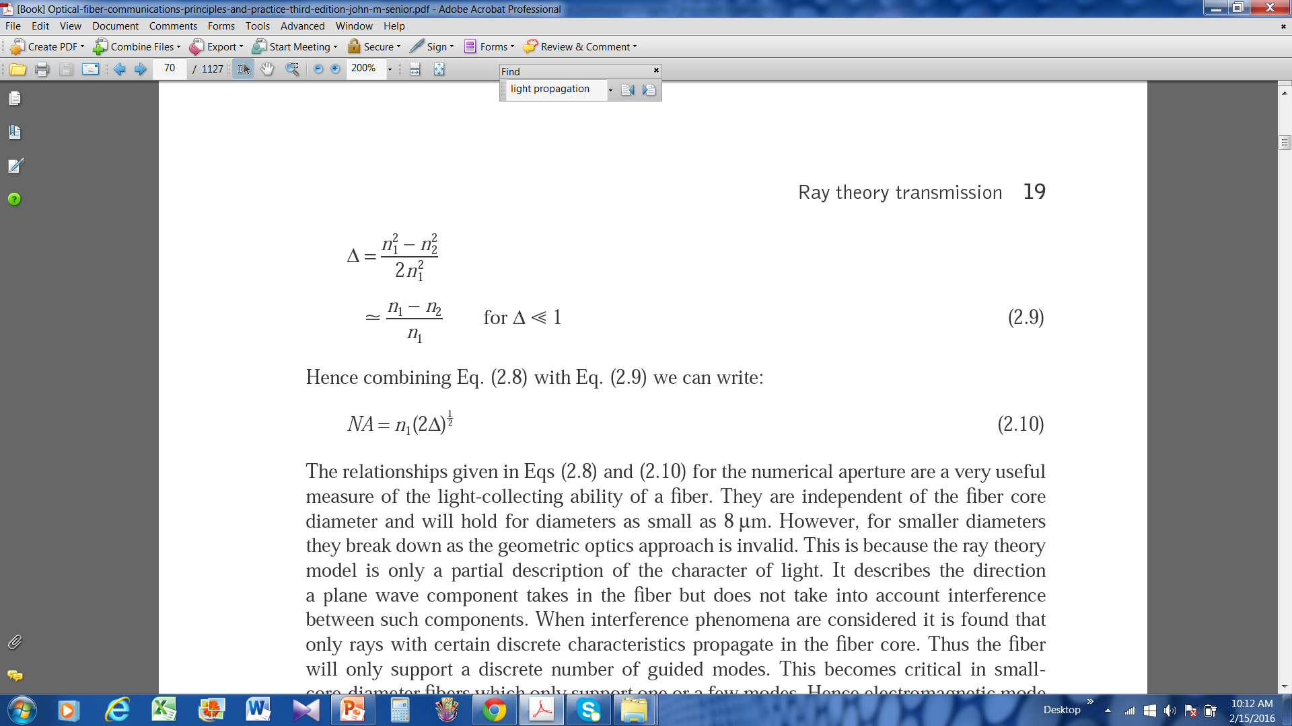
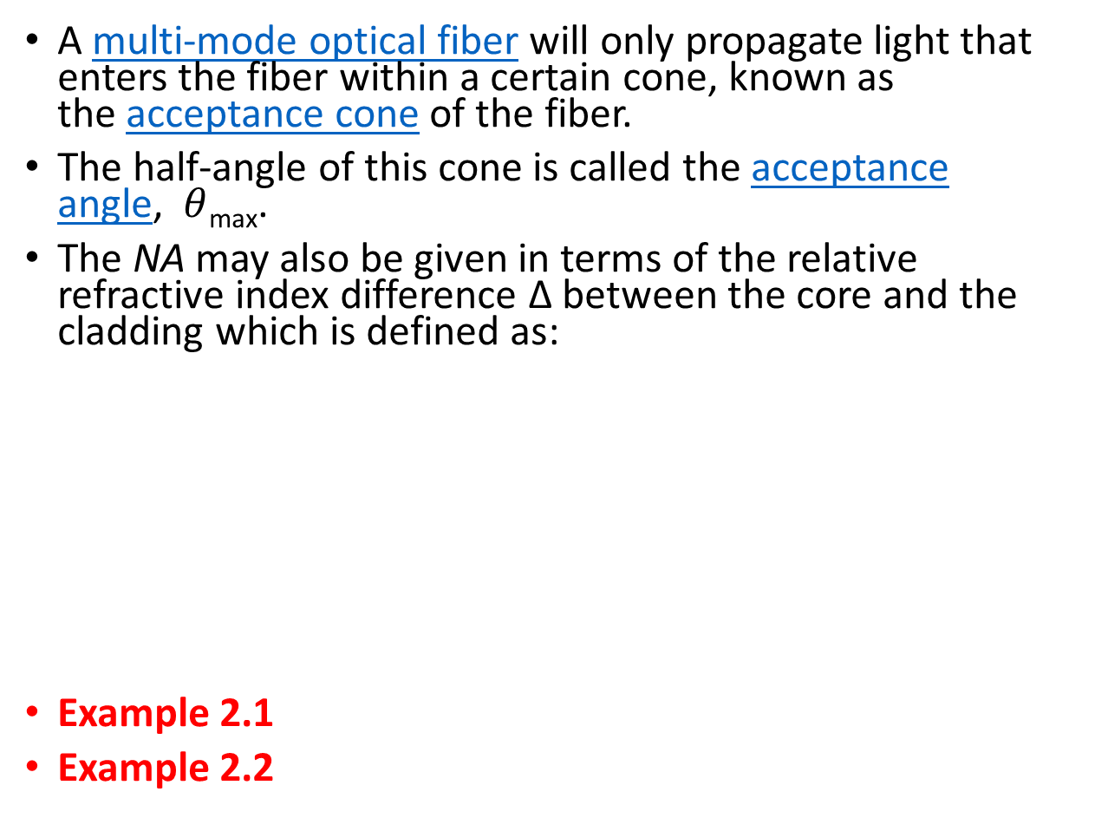
Numerical Aperture
A multi-mode optical fiber will only propagate light that enters the fiber within a certain cone, known as the acceptance cone of the fiber.
The half-angle of this cone is called the acceptance angle, $θ$_{max}.
The NA may also be given in terms of the relative refractive index difference Δ between the core and the cladding which is defined as:
Example 2.1
Example 2.2

Slide 28
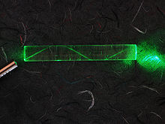
Single-mode fiber
Fiber supporting only one mode is called single-ode or mono-mode fiber.
In fiber-optic communication, a single-mode optical fiber (SMF) is an optical fiber designed to carry light only directly down the fiber.
Signle mode fibers are constructed by letting dimensions of the core diameter be a few wavelength and by having small index differences between the core and the cladding.

Slide 29
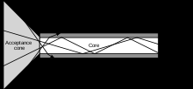
Multi-mode fiber
Fiber with large core diameter (greater than 10 micrometers) may be analyzed by geometrical optics. Such fiber is called multi-mode fiber, from the electromagnetic analysis.
Multi-mode optical fiber is a type of optical fiber mostly used for communication over short distances, such as within a building or on a campus.

Slide 30
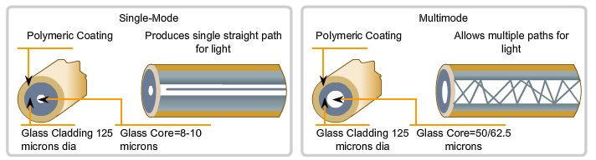
Single mode vs. Multimode Fibers
Single-Mode | Multimode
Small core Less dispersion Carry a single ray of light, usually generated from a laser. Employ for long distance applications (100Km) Uses as Backbone and distances of several thousands meters. | Larger core than single mode cable. Allows greater dispersion and therefore, loss of signal. Used for shorter distance application, but shorter than single-mode (up to 2Km) It uses LED source that generates differtes angles along cable. Often uses in LANs or small distances such as campus networks.

Slide 31
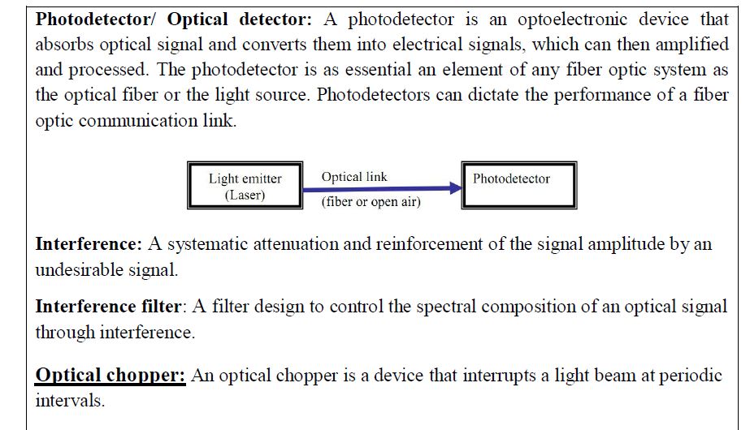
Photo detector

Slide 32
Optical light source
Three main types of optical light source are available. These are:
(a) wideband ‘continuous spectra’ sources
(b) monochromatic incoherent sources (light-emitting diodes, LEDs);
(c) monochromatic coherent sources (lasers).

Slide 33
Major requirements for an optical source
1. A size and configuration compatible with launching light into an optical fiber. Ideally, the light output should be highly directional.
2. Must accurately track the electrical input signal to minimize distortion and noise. Ideally, the source should be linear.
3. Should emit light at wavelengths where the fiber has low losses and low dispersion and where the detectors are efficient.
4. Preferably capable of simple signal modulation over a wide bandwidth extending from audio frequencies to beyond the gigahertz range.
5. Must couple sufficient optical power to overcome attenuation in the fiber plus additional connector losses and leave adequate power to drive the detector.
6. Should have a very narrow spectral bandwidth (line width) in order to minimize dispersion in the fiber.
7. Must be capable of maintaining a stable optical output which is largely unaffected by changes in ambient conditions (e.g. temperature).
8. It is essential that the source is comparatively cheap and highly reliable in order to compete with conventional transmission techniques.

Slide 34
Losses in fiber

Slide 35
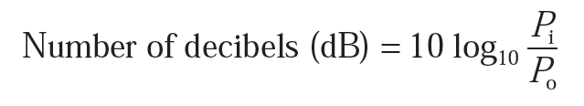
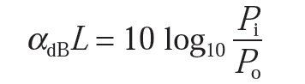
Attenuation
Attenuation -> transmission loss
The ratio of the input (transmitted) optical power P_{i} into a fiber to the output (received) optical power P_{o}:
In optical fiber communications the attenuation is usually expressed in decibels per unit length (i.e. dB km−1) following:
where α_{dB} is the signal attenuation per unit length in decibels which is also referred to as the fiber loss parameter and L is the fiber length.

Slide 36
Attenuation
Attenuation in optical fiber is caused by
Absorption (Intrinsic and extrinsic)
Scattering (Rayleigh and Mie)
Bending (Micro bend and Macro bend)

Slide 37
Material absorption losses in silica glass fibers
Material absorption is a loss mechanism related to the material composition and the fabrication process for the fiber
Two types:
Intrinsic - interaction with one or more of the major components of the glass
Extrinsic - impurities within the glass
Intrinsic absorption:
An absolutely pure silicate glass has little intrinsic absorption due to its basic material structure in the near-infrared region.

Slide 38
Linear scattering losses
One propagating mode to be transferred linearly into a different mode
Two major types:
Rayleigh and Mie scattering.
Rayleigh scattering:
Rayleigh scattering is the dominant intrinsic loss mechanism in the low-absorption window between the ultraviolet and infrared absorption tails.

Slide 39
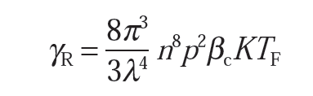
In optical fiber, for a single-component glass this is given by:
where γ_{R} is the Rayleigh scattering coefficient, λ is the optical wavelength, n is the refractive index of the medium, p is the average photoelastic coefficient, β_{c} is the isothermal compressibility at a fictive temperature T_{F}, and K is Boltzmann’s constant.
The fictive temperature is defined as the temperature at which the glass can reach a state of thermal equilibrium and is closely related to the anneal temperature.

Slide 40

Furthermore, the Rayleigh scattering coefficient is related to the transmission loss factor (transmissivity) of the fiber following the relation:
where L is the length of the fiber.
Example 3.1 (John M. Senior)
Example 3.2

Slide 41
Mie scattering:
The scattering created by inhomogeneities is called Mie scattering. Depending upon the fiber material, design and manufacture, Mie scattering can cause significant losses.
The inhomogeneities may be reduced by:
(a) removing imperfections due to the glass manufacturing process;
(b) carefully controlled extrusion and coating of the fiber;
(c) increasing the fiber guidance by increasing the relative refractive index difference.

Slide 42
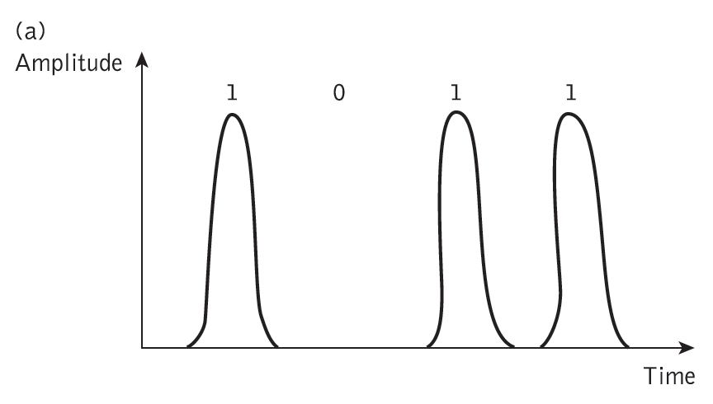
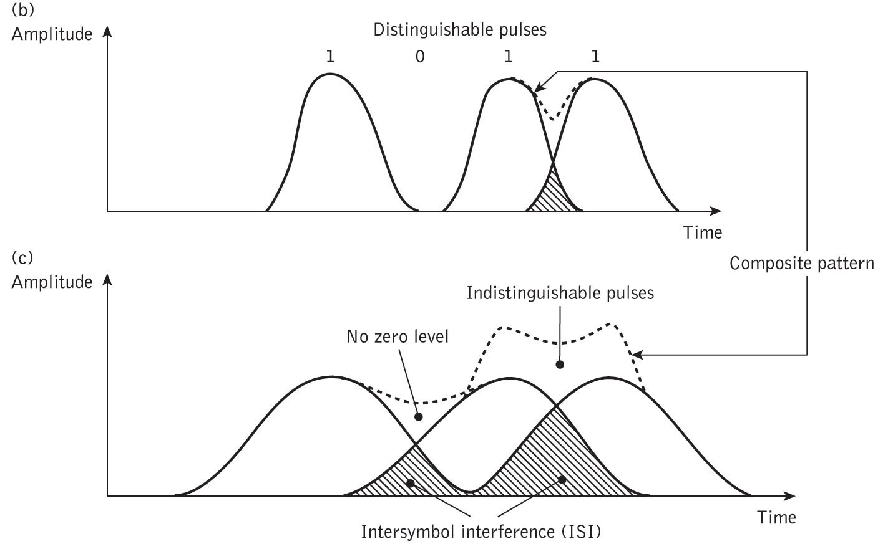
Dispersion
Dispersion of the transmitted optical signal causes distortion for both digital and analog transmission along optical fibers.
Intermodal dispersion
Intra-modal dispersion
Material dispersion
Waveguide dispersion

Slide 43
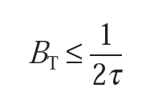

For no overlapping of light pulses down on an optical fiber link the digital bit rate B_{T} must be less than the reciprocal of the broadened (through dispersion) pulse duration (2τ).
This is the conservative estimate.
The maximum bit rate is given approximately by considering the light pulses at the output to have a Gaussian shape with an rms width of σ.

Slide 44
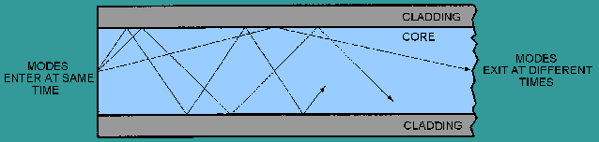
Intermodal dispersion
Results from the propagation delay difference between modes
Modes of light pulses that enter the fiber at one time, exit the fiber at different times
pulse width at the output is dependent upon the transmission times of the slowest and fastest order modes

Slide 45
Intra-modal or chromatic dispersion
Optical source emits a band of frequencies
This type of dispersion depends primarily on fiber materials
Different spectral components travel trough different materials and different waveguide structures at different speeds
There are two types of chromatic dispersion (material dispersion and waveguide dispersion)
Material dispersion is a function of the spectral width.
WD occurs because propagation constant is a function of the wavelength of operation

Slide 46
Fiber bend loss
See John M. Senior book

